Slide 1

Logistic Regression

Slide 2
ML
Machine learning
Machine learning uses artificial intelligence to enable machines to learn and predict outcomes more accurately without being explicitly programmed to do so. This makes them more similar to humans. The machine learning models continuously learns and improves its performance with the use of necessary data.

Slide 3
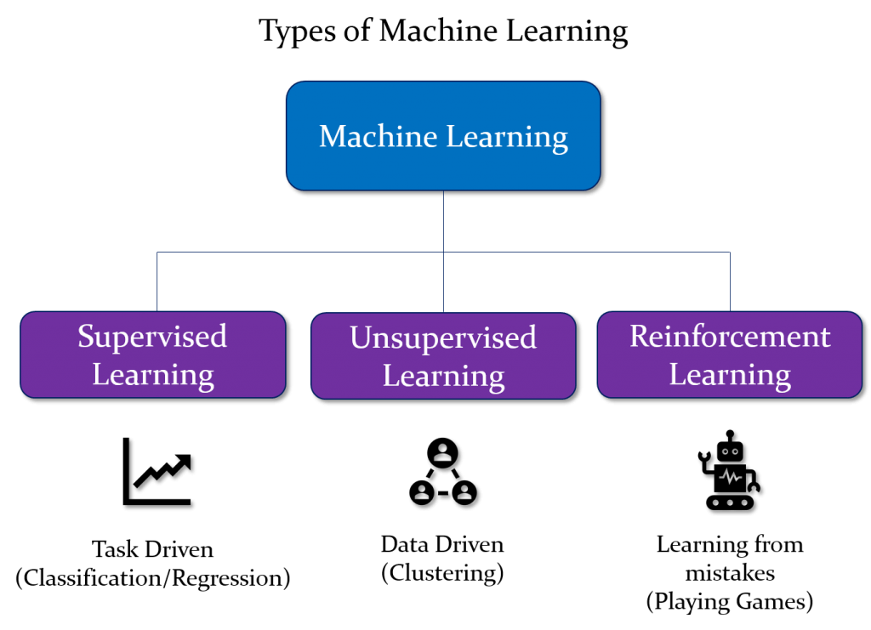

Slide 4
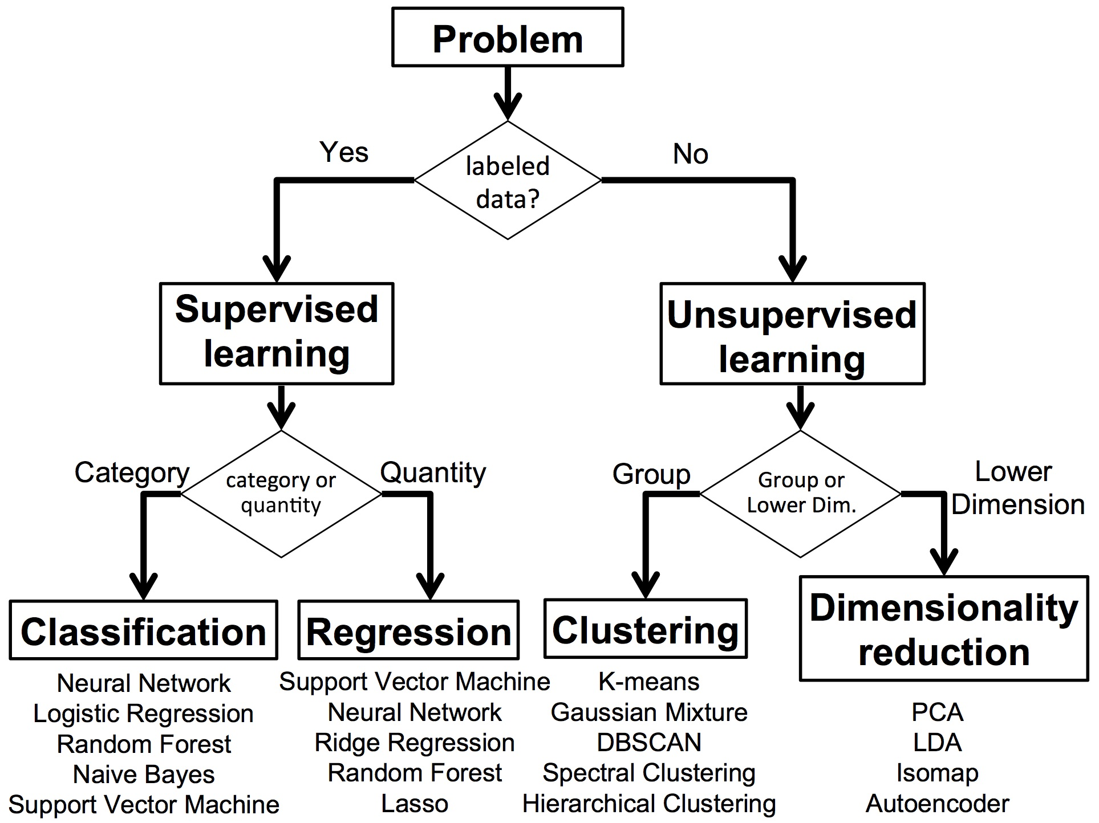

Slide 5
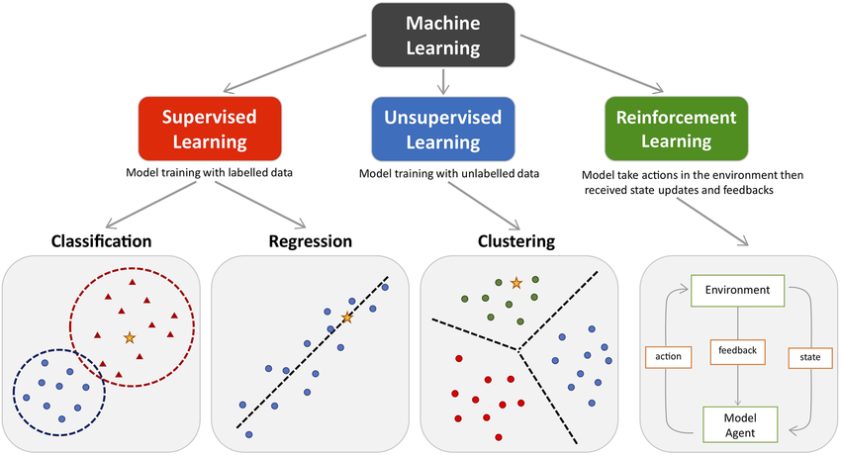

Slide 6
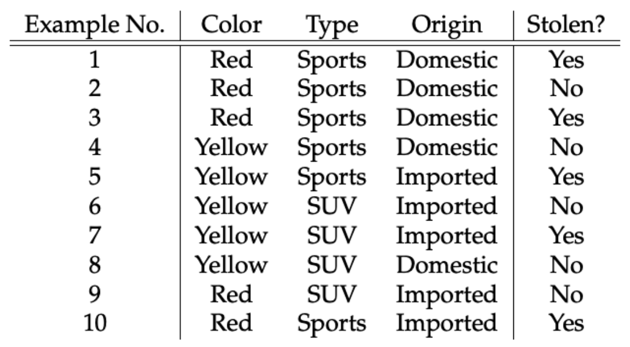
Tabular data to predict whether car is stolen or not?
Features
Label

Slide 7
Data
ML Algorithm
ML Model

Slide 8
Steps in ML
1. Data collection
2. Data preparation
3. Choose a ML model
4. Train the model
5. Evaluate the model
7. Make predictions
6. Parameter tuning

Slide 9
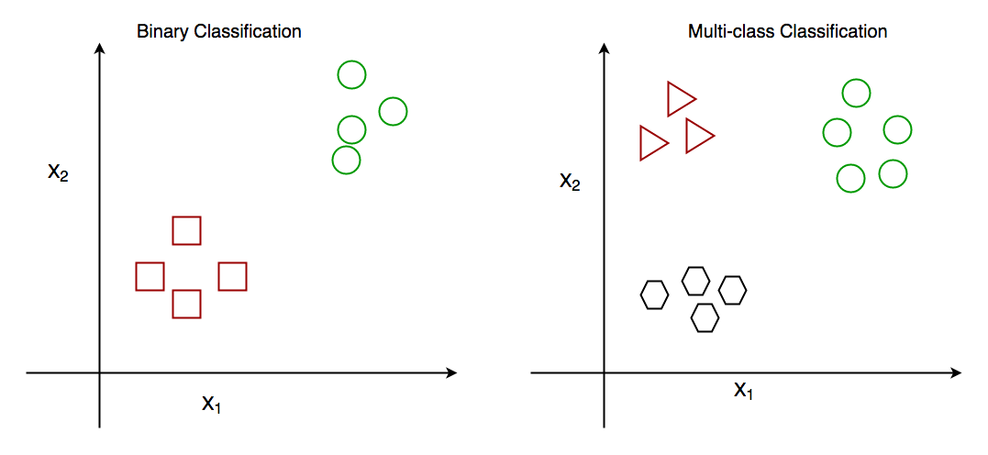
Classification: Classification algorithms are used to predict a categorical output. For example, a classification algorithm could be used to predict whether an email is spam or not.
Classification Types
There are two main classification types in machine learning:
Binary Classification
Multiclass Classification
Classification Algorithms
There are various types of classifiers algorithms. Some of them are :
Linear Classifiers
Non-Linear Classifiers
https://www.geeksforgeeks.org/getting-started-with-classification/

Slide 10
Linear Classifiers
Linear models create a linear decision boundary between classes. They are simple and computationally efficient. Some of the linear classification models are as follows:
Logistic Regression
Support Vector Machines having kernel = ‘linear’
Single-layer Perceptron
Stochastic Gradient Descent (SGD) Classifier
Non-linear Classifiers
Non-linear models create a non-linear decision boundary between classes. They can capture more complex relationships between the input features and the target variable. Some of the non-linear classification models are as follows:
K-Nearest Neighbours
Kernel SVM
Naive Bayes
Decision Tree Classification
Ensemble learning classifiers:
Random Forests,
AdaBoost,
Bagging Classifier,
Voting Classifier,
Multi-layer Artificial Neural Networks

Slide 11
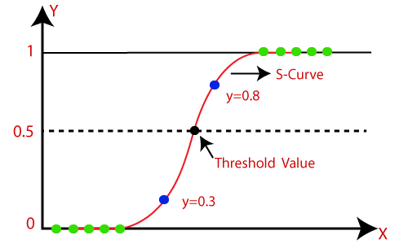
Logistic Regression
Introduction to Logistic Regression
Sigmoid Function
Confusion Matrix
Classification Evaluation Metrics
Logistic regression predicts the output of a categorical dependent variable. Therefore the outcome must be a categorical or discrete value. It can be either Yes or No, 0 or 1, true or False, etc. but instead of giving the exact value as 0 and 1, it gives the probabilistic values which lie between 0 and 1.
Assumptions for Logistic Regression:
The dependent variable must be categorical in nature.
The independent variable should not have multi-collinearity.

Slide 12
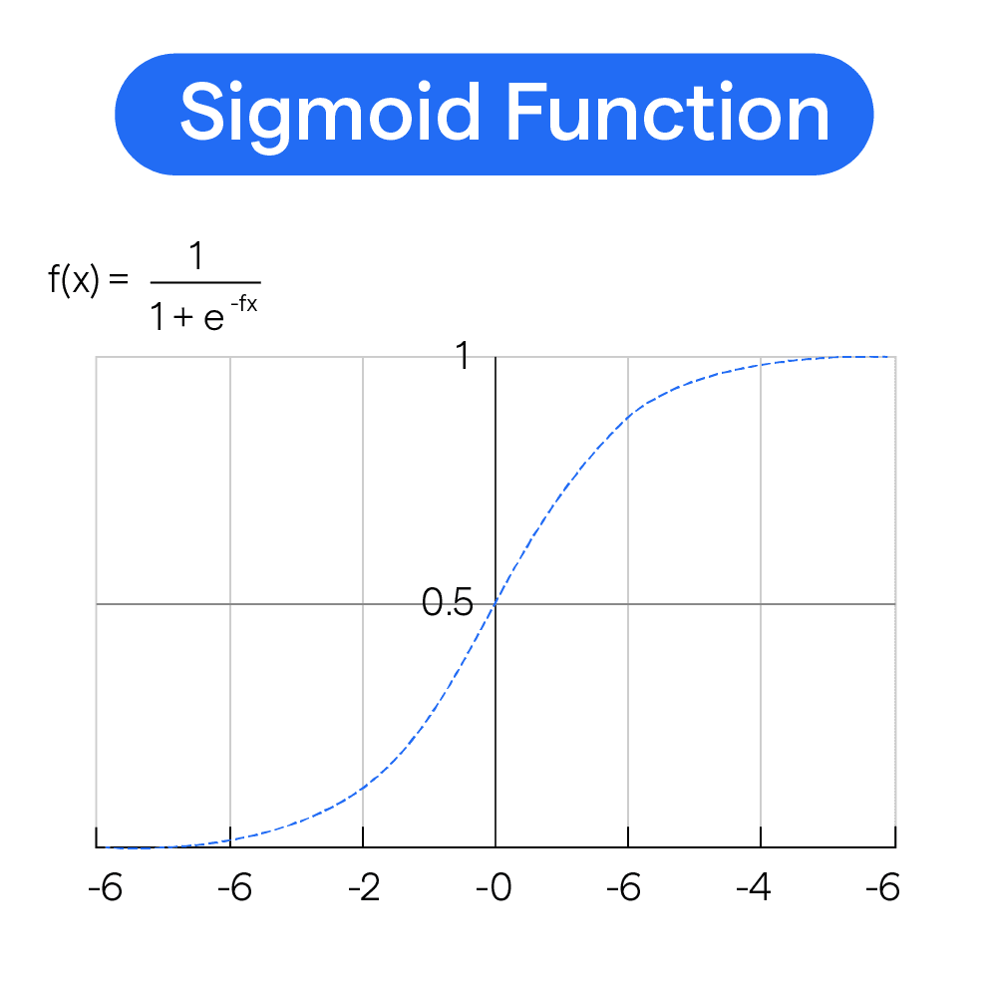
Logistic Function (Sigmoid Function):
The sigmoid function is a mathematical function used to map the predicted values to probabilities.
It maps any real value into another value within a range of 0 and 1.
The value of the logistic regression must be between 0 and 1, which cannot go beyond this limit, so it forms a curve like the "S" form. The S-form curve is called the Sigmoid function or the logistic function.
In logistic regression, we use the concept of the threshold value, which defines the probability of either 0 or 1. Such as values above the threshold value tends to 1, and a value below the threshold values tends to 0.

Slide 13
Type of Logistic Regression:
On the basis of the categories, Logistic Regression can be classified into three types:
Binomial: In binomial Logistic regression, there can be only two possible types of the dependent variables, such as 0 or 1, Pass or Fail, etc.
Multinomial: In multinomial Logistic regression, there can be 3 or more possible unordered types of the dependent variable, such as "cat", "dogs", or "sheep"
Ordinal: In ordinal Logistic regression, there can be 3 or more possible ordered types of dependent variables, such as "low", "Medium", or "High".
#Fitting Logistic Regression to the training set
from sklearn.linear_model import LogisticRegression
classifier= LogisticRegression(random_state=0)
classifier.fit(x_train, y_train)

Slide 14
Cost functions/loss function in logistic regression
Log loss
L1 (feature selection ,lasso)and L2(reduction overfitting ridge) regularization
C & lambda relationship (lambda is hyper parameter )

Slide 15
Classification Models in Machine Learning
Evaluating a classification model is an important step in machine learning, as it helps to assess the performance and generalization ability of the model on new, unseen data. There are several metrics and techniques that can be used to evaluate a classification model, depending on the specific problem and requirements. Here are some commonly used evaluation metrics:
Classification Accuracy: The proportion of correctly classified instances over the total number of instances in the test set. It is a simple and intuitive metric but can be misleading in imbalanced datasets where the majority class dominates the accuracy score.
Confusion matrix: A table that shows the number of true positives, true negatives, false positives, and false negatives for each class, which can be used to calculate various evaluation metrics.
Precision and Recall: Precision measures the proportion of true positives over the total number of predicted positives, while recall measures the proportion of true positives over the total number of actual positives. These metrics are useful in scenarios where one class is more important than the other, or when there is a trade-off between false positives and false negatives.
F1-Score: The harmonic mean of precision and recall, calculated as 2 x (precision x recall) / (precision + recall). It is a useful metric for imbalanced datasets where both precision and recall are important.
ROC curve and AUC: The Receiver Operating Characteristic (ROC) curve is a plot of the true positive rate (recall) against the false positive rate (1-specificity) for different threshold values of the classifier’s decision function. The Area Under the Curve (AUC) measures the overall performance of the classifier, with values ranging from 0.5 (random guessing) to 1 (perfect classification).
Cross-validation: A technique that divides the data into multiple folds and trains the model on each fold while testing on the others, to obtain a more robust estimate of the model’s performance.

Slide 16
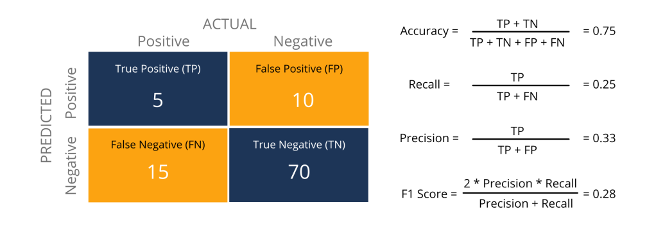
Metrics to Evaluate your Classification Model
https://www.analyticsvidhya.com/blog/2021/07/metrics-to-evaluate-your-classification-model-to-take-the-right-decisions/

Slide 17
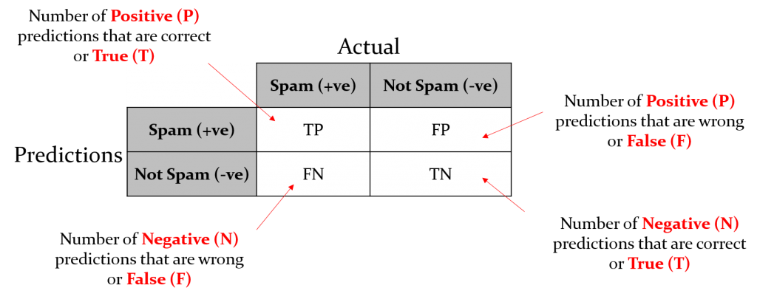
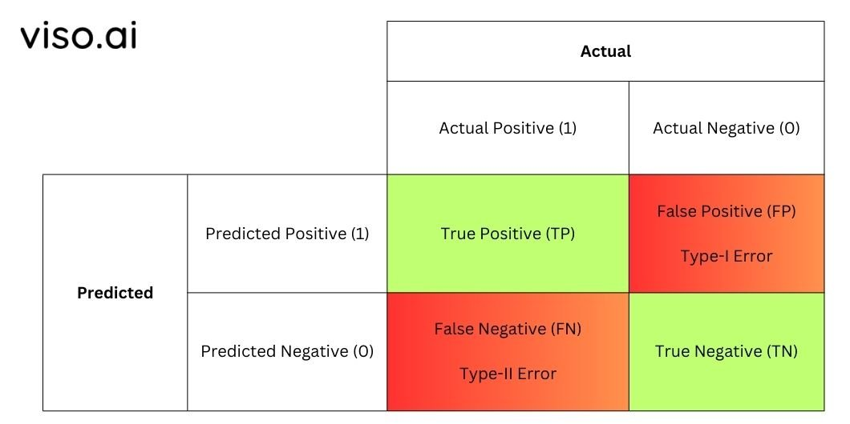
confusion-matrix-machine-learning
https://www.geeksforgeeks.org/confusion-matrix-machine-learning/

Slide 18

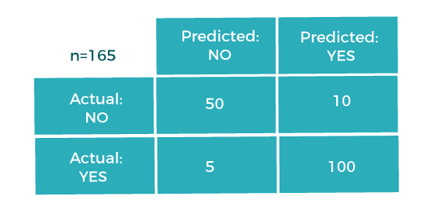


It is recommended not to use the Accuracy measure when the target variable majorly belongs to one class.
II. Confusion Matrix
III. Precision
The precision metric is used to overcome the limitation of Accuracy. The precision determines the proportion of positive prediction that was actually correct.
IV. Recall or Sensitivity
It is also similar to the Precision metric; however, it aims to calculate the proportion of actual positive that was identified incorrectly. It can be calculated as True Positive or predictions that are actually true to the total number of positives,
https://www.javatpoint.com/performance-metrics-in-machine-learning
https://www.kaggle.com/code/prashant111/logistic-regression-classifier-tutorial
Implementations with all in one

Slide 19
import numpy as np
import matplotlib.pyplot as plt
from sklearn.metrics import confusion_matrix, ConfusionMatrixDisplay
from sklearn.model_selection import train_test_split
from sklearn.datasets import load_iris
from sklearn.ensemble import RandomForestClassifier
# Load a sample dataset
data = load_iris()
X, y = data.data, data.target
# Split the dataset into training and testing sets
X_train, X_test, y_train, y_test = train_test_split(X, y, test_size=0.3, random_state=42)
# Train a classification model
model = RandomForestClassifier(random_state=42)
model.fit(X_train, y_train)
# Make predictions
y_pred = model.predict(X_test)
# Generate the confusion matrix
cm = confusion_matrix(y_test, y_pred)
# Display the confusion matrix
disp = ConfusionMatrixDisplay(confusion_matrix=cm, display_labels=data.target_names)
disp.plot(cmap=plt.cm.Blues)
plt.title("Confusion Matrix")
plt.show()
# Calculate evaluation metrics
TP = np.diag(cm) # True Positives
FP = np.sum(cm, axis=0) - TP # False Positives
FN = np.sum(cm, axis=1) - TP # False Negatives
precision = TP / (TP + FP)
recall = TP / (TP + FN)
f1_score = 2 * (precision * recall) / (precision + recall)
print("Precision:", precision)
print("Recall:", recall)
print("F1-Score:", f1_score)

Slide 20
Confusion Matrix
Understanding Performance:
Provides a detailed overview of a classification model’s performance beyond simple accuracy.
Highlights true positives, true negatives, false positives, and false negatives for deeper insights.
Use Case:
Medical Diagnostics: Identifies how many actual diseases were correctly diagnosed (true positives) vs. missed diagnoses (false negatives).
Precision, Recall, and F1-Score
Precision:
Measures the accuracy of positive predictions, crucial when false positives are costly.
Use Case:
Fraud Detection: High precision ensures that few legitimate transactions are incorrectly flagged as fraud.
Recall:
Assesses the model's ability to identify all relevant instances, vital in minimizing false negatives.
Use Case:
Spam Detection: High recall ensures that most spam emails are captured, reducing user exposure to unwanted content.
F1-Score:
Combines precision and recall into a single metric, particularly useful in imbalanced datasets.
Use Case:
Customer Churn Prediction: Balances the need to accurately predict both churn and non-churn customers in a highly imbalanced dataset.

Slide 21
ROC Curve and AUC
ROC Curve (Receiver Operating Characteristic)
Definition:
A graphical representation of a classifier's performance across different threshold values.
Plots the True Positive Rate (TPR) against the False Positive Rate (FPR).
AUC (Area Under the Curve)
Definition:
Measures the overall performance of the classifier.
AUC value ranges from 0 to 1, where:
0.5: No discriminative ability (random guessing).
1: Perfect classification.
# Get predicted probabilities for the positive class
y_scores = model.predict_proba(X_test)[:, 1]
# Calculate ROC curve
fpr, tpr, thresholds = roc_curve(y_test, y_scores)
# Calculate AUC
roc_auc = auc(fpr, tpr)
# Plot ROC curve
plt.figure()
plt.plot(fpr, tpr, color='blue', label=f'ROC curve (AUC = {roc_auc:.2f})')
plt.plot([0, 1], [0, 1], color='red', linestyle='--') # Diagonal line
plt.xlim([0.0, 1.0])
plt.ylim([0.0, 1.05])
plt.xlabel('False Positive Rate')
plt.ylabel('True Positive Rate')
plt.title('Receiver Operating Characteristic (ROC) Curve')
plt.legend(loc='lower right')
plt.grid()
plt.show()
import numpy as np
import matplotlib.pyplot as plt
from sklearn.datasets import load_iris
from sklearn.model_selection import train_test_split
from sklearn.ensemble import RandomForestClassifier
from sklearn.metrics import roc_curve, auc
# Load the Iris dataset
data = load_iris()
X, y = data.data, data.target
# For binary classification, let's use only two classes (0 and 1)
X = X[y != 2]
y = y[y != 2]
# Split the dataset into training and testing sets
X_train, X_test, y_train, y_test = train_test_split(X, y, test_size=0.3, random_state=42)
# Train a Random Forest classifier
model = RandomForestClassifier(random_state=42)
model.fit(X_train, y_train)

